Slide 1
Private Label Food Setup
USA Design Validation Workshop
w/c: 21st August 2006

Slide 2
Agenda
Product Types
Deployment Timeline
Supplier and the Technical Library
Process Overview

Slide 3
Product Types
Four high-level product types to confirm
Private Label Food
Private Label non-Food
Kitchen
Branded
Key Questions on the Product Types
Will PL non-food products be managed in the technical library?
Will Kitchen products be managed in the technical library?

Slide 4
Deployment Timeline
Launch Milestones
  25 Sept
Bus Trip
Range 1 Sign-off
  2 Jan
Mock Store
Filled
  30 Mar
Planograms
Complete
  2 Apr
Product File
Complete
Process State
Interim
Pre-Launch
End State
Capability Deployment
  4 Sept
Interim TTL Tool Live
  30 Oct
U.S. TTL Live
  28 Feb
Begin RMS
Launch
  21 Mar
RMS Live

Slide 5
Supplier
Suppliers will manage multiple sites (as required) under one Supplier Code in the Technical Library
The Supplier Code and Site Code will be managed differently in the Pre-Launch and End State processes
Interim & Pre-Launch
End State
Supplier Code
=
Oracle Fin.
Vendor
Supplier Code
=
RMS A/P
Supplier
Site Code
Site Code
=
Oracle Fin.
Site
Site Code
Site Code
=
RMS Supplier

Slide 6
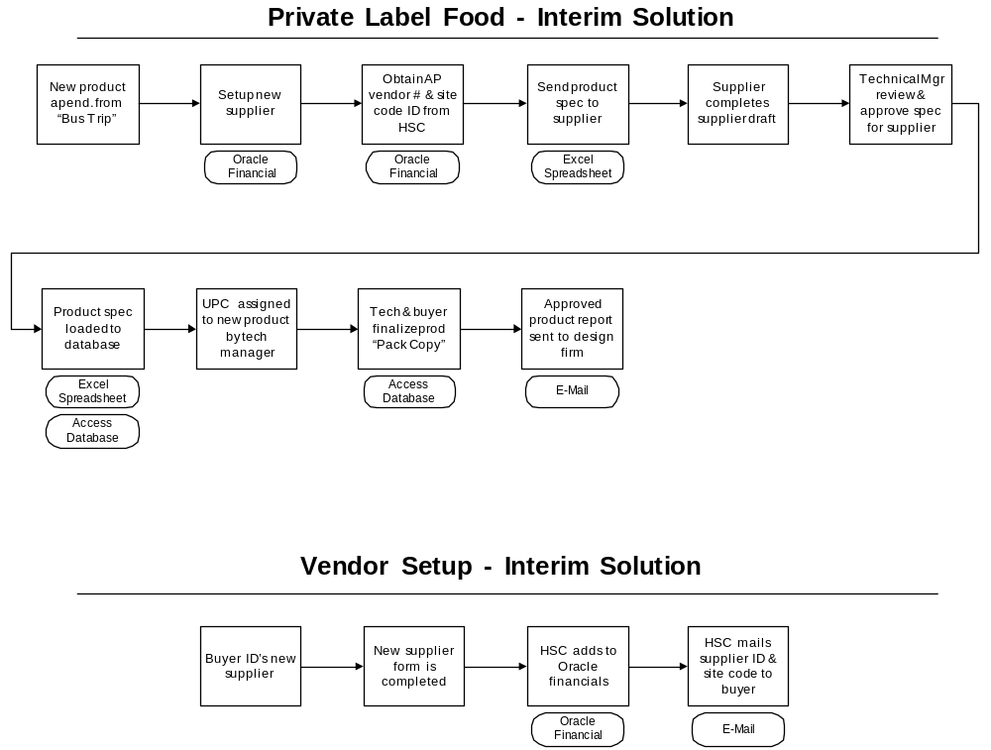
In the interim solution an Excel Spreadsheet is e-mailed to Suppliers. UPC’s are assigned in a central Access database where approved specs are completed
Issues:
Supplier set-up process in the interim needs to be confirmed.
UPC type and assignment process need to agreed
Overall governance procedure to be confirmed

Slide 7
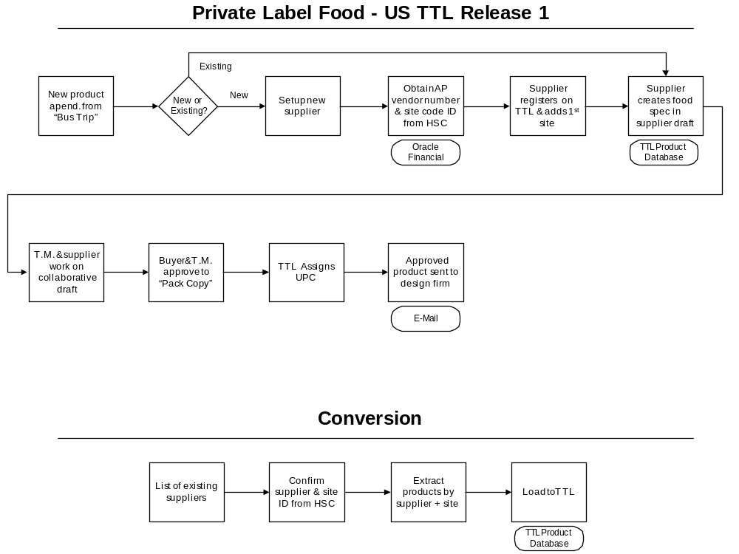
The US Technical Library is scheduled for completion in by end of October, existing specs from the interim solution will be converted to the Web Based solution.
Issues:
Process for adding sites to an existing supplier
TTL automated UPC assignment
Manual conversion process

Slide 8
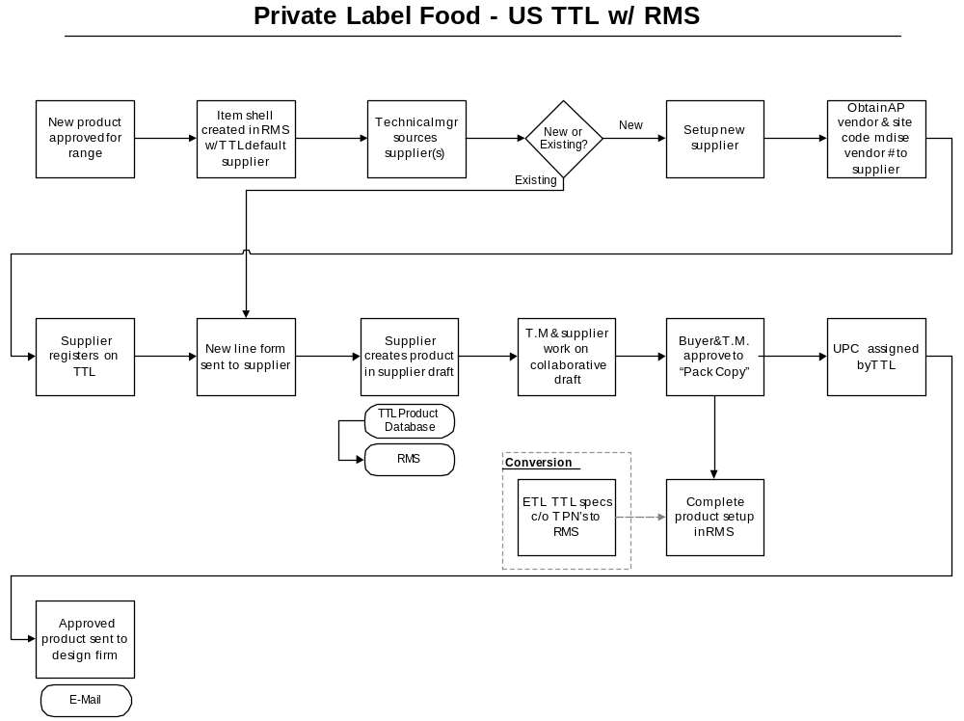
In the future state, RMS will be the system of record for all product data. New products will be initiated in RMS and completed when the product spec is approved.
Issues:
Does the RMS shell need to exist before TTL setup
Does TTL need the RMS product number
No interfaces have been scoped for the initial release

